Slide 1

Department of Computer Science Gujarat University
5 Year Integrated M.Sc.(Computer Science)
Semester - VI
Identification and Addressing Gender Bias in
Content
Presented By:
Ansh Yadav ( 60027 )
Under the Guidance of :
Dr. Hardik Joshi

Slide 2
Index
Sr. No | Index | Page No.
1. | Project Profile........................................................................................ | 1
2. | Introduction.......................................................................................... | 5
3. | Information Repository......................................................................... | 6
4. | Data Mining.......................................................................................... | 9
5. | Research Problem................................................................................. | 11
6. | Methodology......................................................................................... | 12
7. | Literature Review.................................................................................. | 13
8. | System Architecture............................................................................. | 17
9. | Data Dictionary..................................................................................... | 23
10. | Screenshots.......................................................................................... | 25
11. | Future Work.......................................................................................... | 37
12. | Bibliography.......................................................................................... | 38

Slide 3
Project Profile
TITLE | DESCRIPTION
Project Title | Identification and Addressing Gender Bias in Content
Aim of the Project | Identify the gender biasness in content and categorize it into different category and sub categories
Project duration | 6 month
Team size | 1 Member
Tools used | Visual Studio code, Git hub
Technologies used | Python, Next.js, Flask, Tailwindcss, MongoDB
Guide | Dr. Hardik Joshi

Slide 4
Project Description

Slide 5
Introduction
In toady’s digital world, We see different content that plays a important role in chaging our perception and behaviour toward the person or community. However, There exists a vast quantity of available content that may promote gender Bias.
As developers, we understand the importance of creating a unbias content. It is crucial to identify and address the gender bias on the software. Identify and address gender bias help the companies and bussiness to track and stop the promotion of that unbias in the business, help to safe guard the gender equality and create a safe enviroment in digital world

Slide 6
Information Repository
“id”: Unique identifier for the tweet.
“tweet”: Text of the tweet.
"labels_task1” : Indicates that tweet contains sexist behaviours Values are: “YES” and “NO”.
“labels_task2” : Indicates the intention of the person and categorize the tweet. Values are: “DIRECT”, “REPORTED”, “JUDGEMENTAL”."
“labels_task3” : Indicating the type of sexism that are found in the tweet. Values are: “IDEOLOGICAL-INEQUALITY”,“STEREOTYPING- DOMINANCE”, “OBJECTIFICATION”, “SEXUAL-VIOLENCE”, “MISOGYNY- NON-SEXUAL-VIOLENCE”,.

Slide 7
Sample Dataset
{
"id": "200001",
"tweet": "Writing a uni essay in my local pub with a coffee. Random old man keeps asking me drunk questions when I'm trying to concentrate &amp; ends with \"good luck, but you'll just end up getting married and not use it anyway\". #EverydaySexism is alive and well “,
"labels_task1": "['YES', 'YES', 'NO', 'NO', 'YES', 'NO']",
"labels_task2": "['JUDGEMENTAL', 'JUDGEMENTAL', '-', '-', 'REPORTED', '-']",
"labels_task3": "[['MISOGYNY-NON-SEXUAL-VIOLENCE'], ['SEXUAL-VIOLENCE'], ['-'], ['- '], ['MISOGYNY-NON-SEXUAL-VIOLENCE'], ['-']]"
},

Slide 8
Data mining
Check is it a unbias or bias text
Remove html tags
Remove accents
Spell checking
Remove hastags
Remove URL
Remove puncutation
Remove Number
Remove Non grammatic word
Lemmatize text

Slide 9
Data mining
Extract only:
Noun (NN)
Verb, base form (VB)
Verb, past tense (VBD)
Verb, present participle (VBG)
Verb, Past Participle (VBN)
Verb, non-3rd person signular present (VBP)
Verb, 3rd person singular present (VBZ)

Slide 10
Sample Training Set
Split in Chunk
Cateogry for 1 task
Cateogry for 2 task
Sample Training Set :
{
"keyword": "novel",
"category_1": ["JUDGEMENTAL"],
"category_2": ["MISOGYNY-NON-SEXUAL-VIOLENCE"]
},

Slide 11
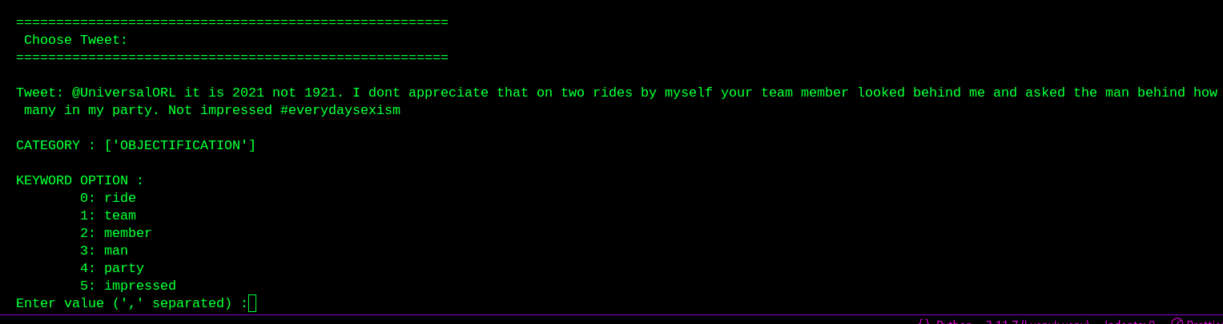
Training Task

Slide 12
Research Problem
What are the methods and technique required to effectively identify and address gender bias in the content of software development and business ?
The aim for Identification and Addressing Gender Bias in the content of a software devlopment and business to stop the unbiasness in the content of software devlopment and promote safe enviroment in the digital realm and promote the unbias and stop discrimination in the software

Slide 13
Methodology
1) Introduction:
Prompted the need for comprehensive analysis and mitigation strategies
Aims to investigate the gender bias within the EXIST 2024 dataset
2) Research Design:
Utilizing a mixed-methods approach
Research employs quantitative analysis to identify patterns
Providing deeper insights into the nature and implications of gender bias
Aims to offer actionable recommendations for addressing gender bias

Slide 14
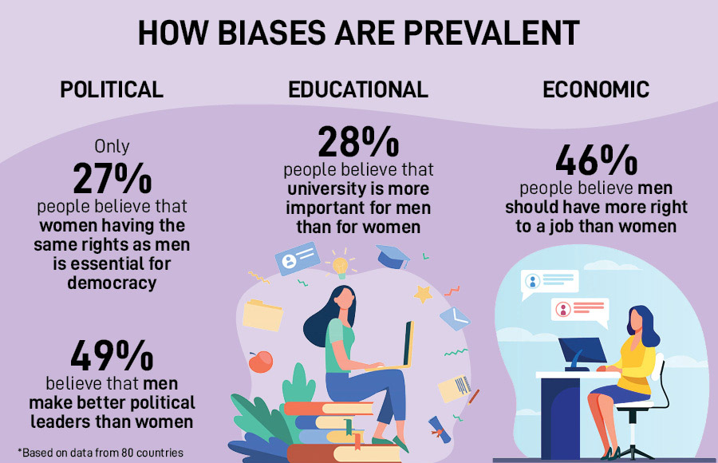
Literature Review (GSNI)
1. Gender Social Norm Index ( GSNI ) - 2020

Slide 15
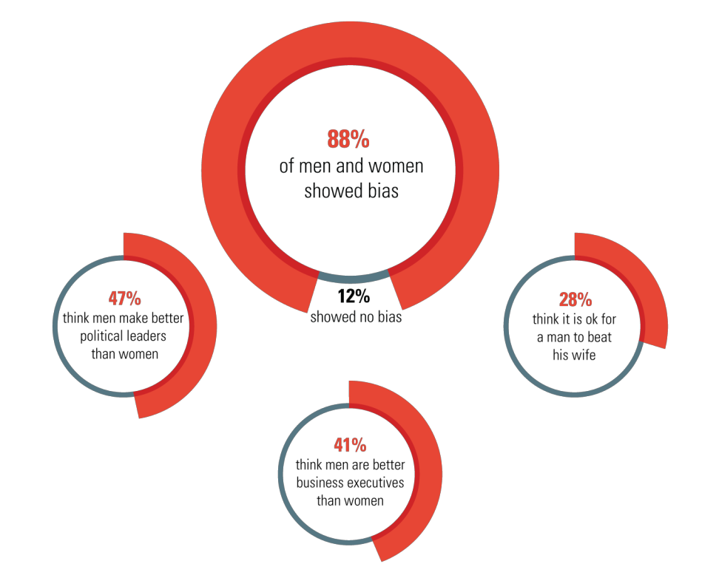
Literature Review
2. United Nation Development Programme ( UNDP ) - 2020

Slide 16
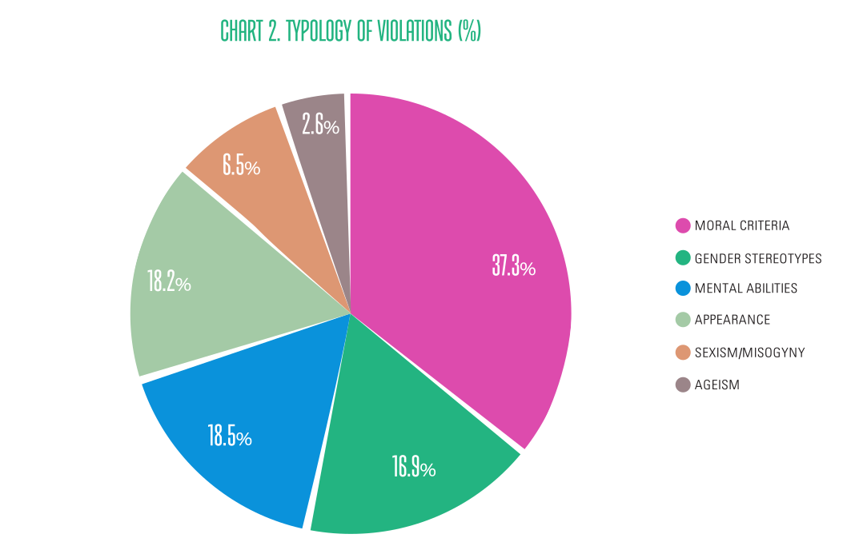
Literature Review
3. Media Development Foundation ( MDF )- 2020

Slide 17
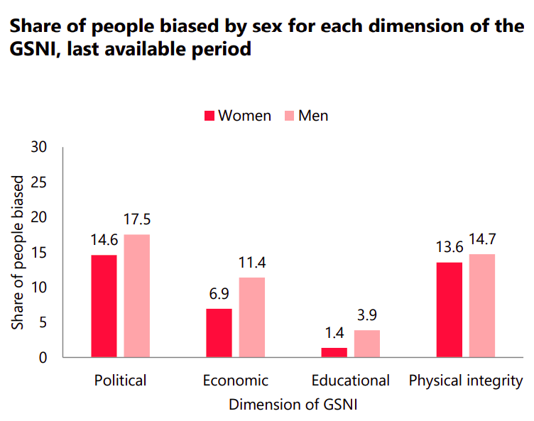
Literature Review
4. Sweden, GSNI - 2020

Slide 18
System Architecture

Slide 19
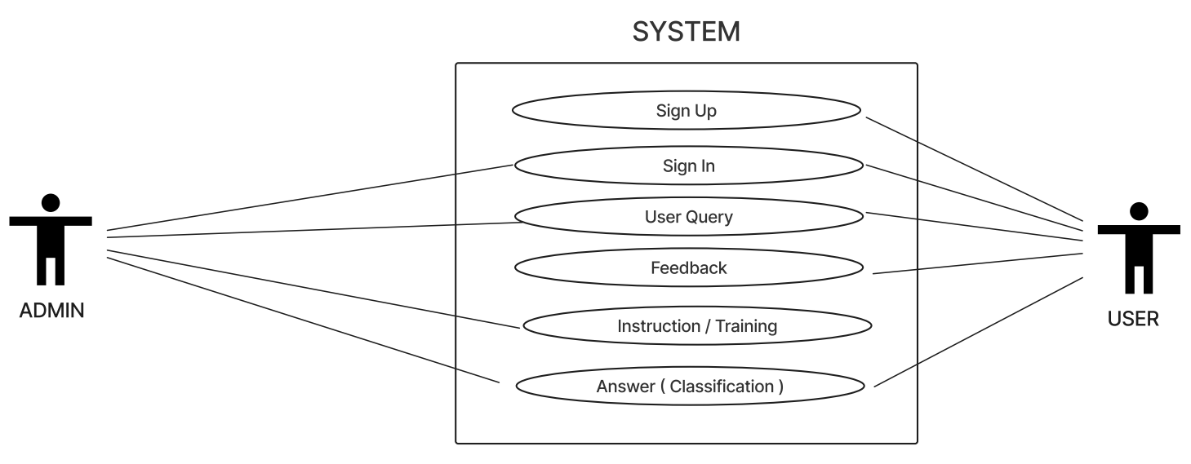
Use Case Diagram

Slide 20
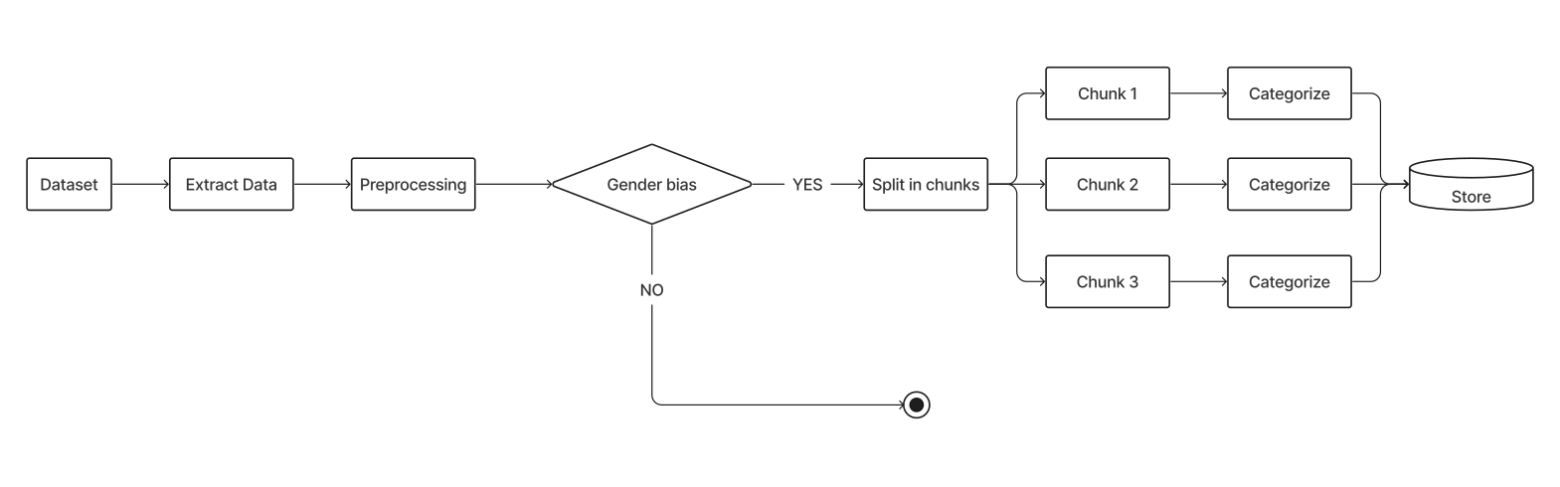
Process diagram

Slide 21
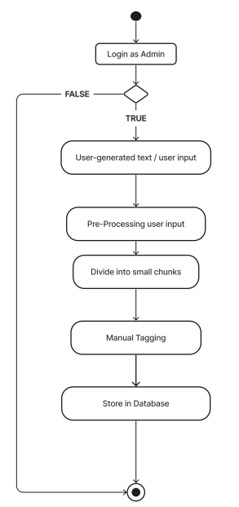
Activity Diagram of Training

Slide 22
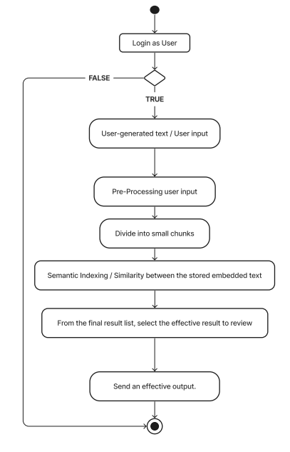
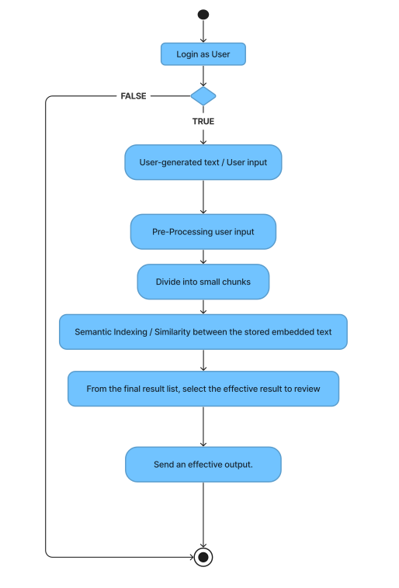
Activity Diagram of Query

Slide 23
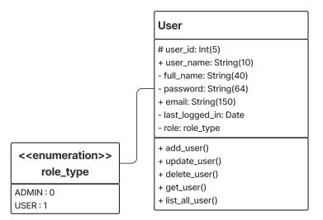
Class Diagram

Slide 24
DATA DICTIONARY

Slide 25
User Table
Seral no | Field name | Type | Size | Link to | Sample data
1 | user_id | INT | 24 |  | 65eabc234f7798607df05963
2 | user_name | STRING | 10 |  | John Wick
3 | full_name | STRING | 40 |  | John Albert Warden Wick
4 | password | STRING | 64 |  | 952316575f25sdfe2a9cbsd035fe3adsc72ddsdd
5 | email | STRING | 150 |  | 90901@gujuniversity.ac.in
6 | last_logged_in | DATE |  |  | 2024-03-30
7 | logged_in | DATE |  |  | 2024-4-12
8 | role_type | ENUM | 0, 1 |  | 0

Slide 26
SCREENSHOTS

Slide 27
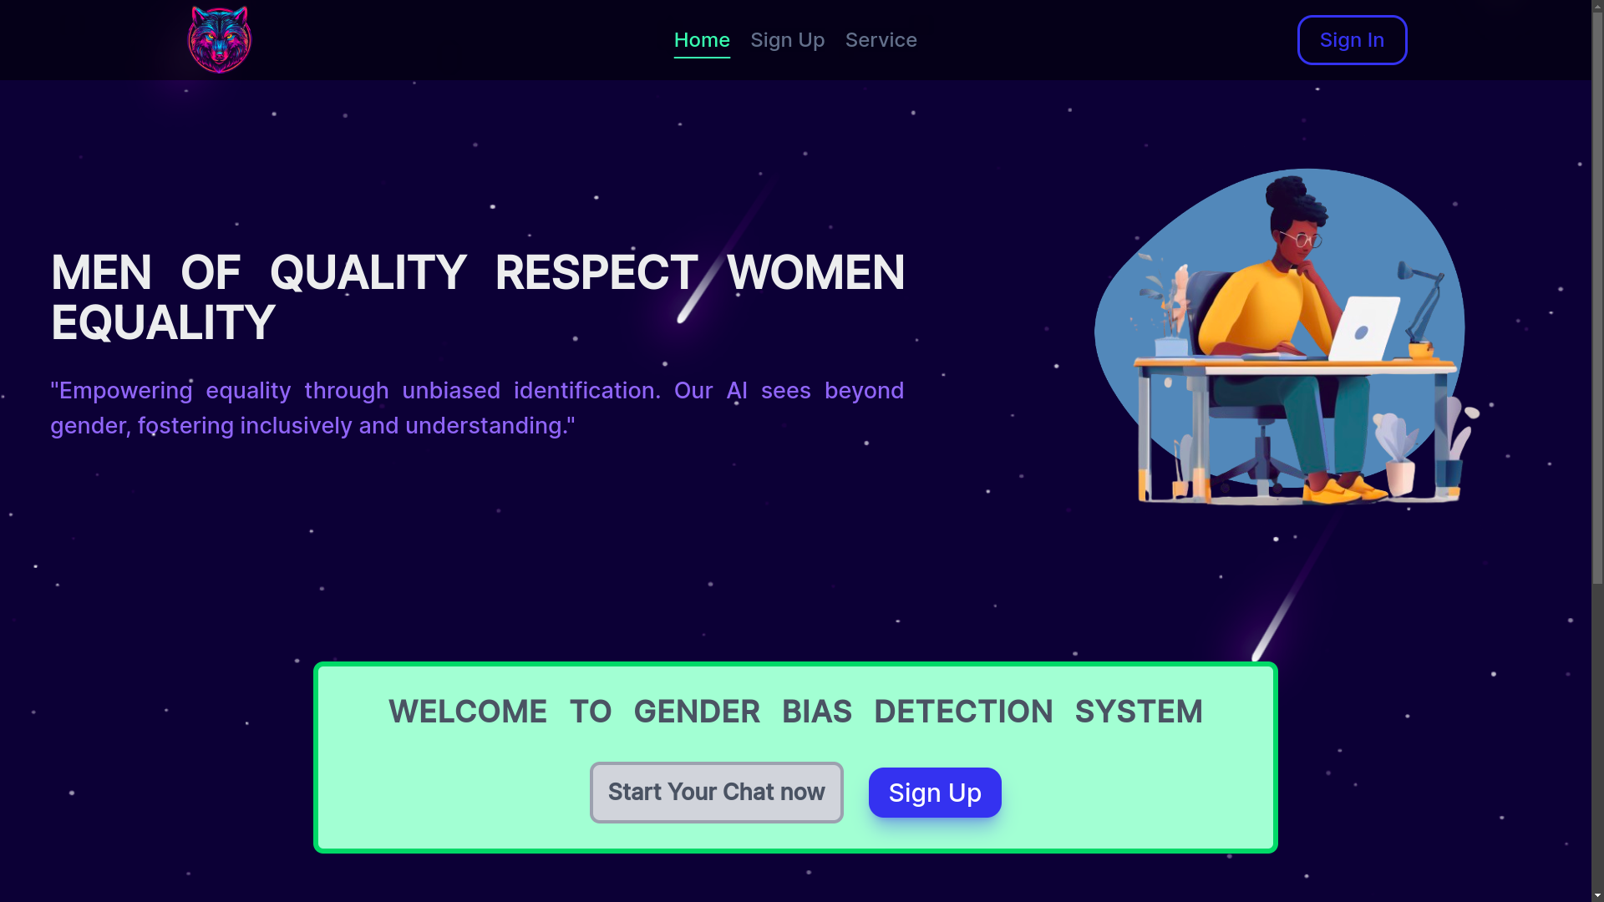
Home Page

Slide 28
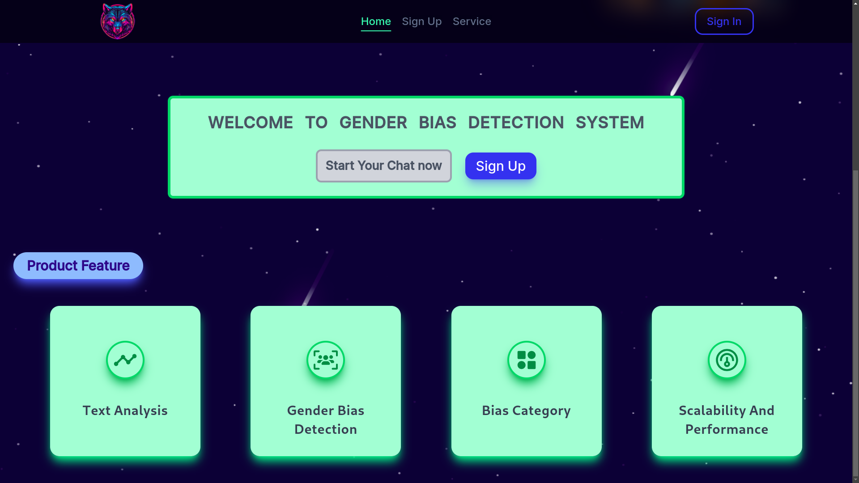
Home Page

Slide 29
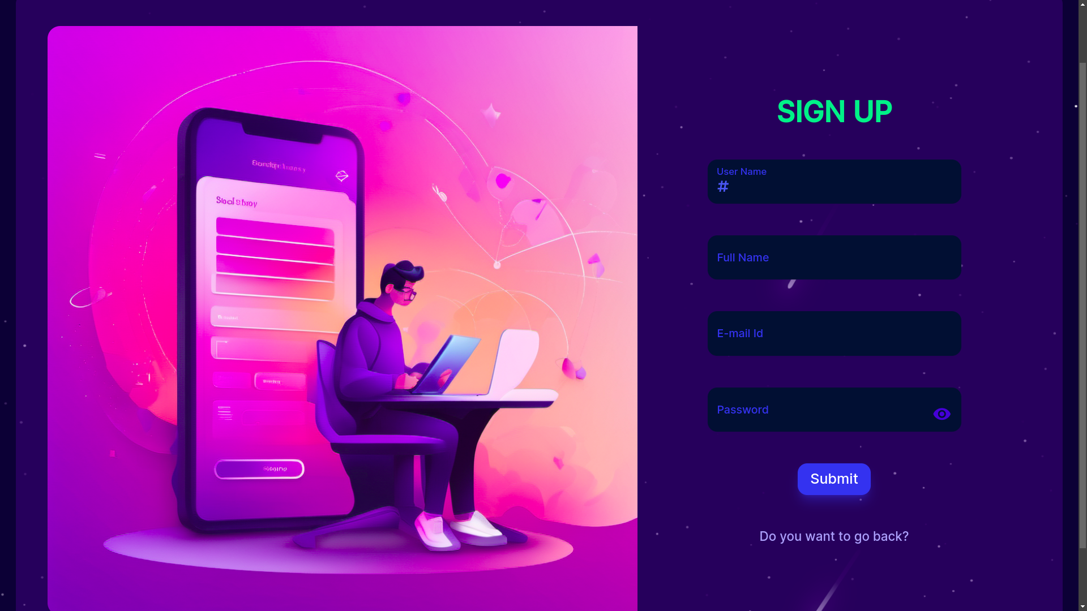
Sign Up Page

Slide 30
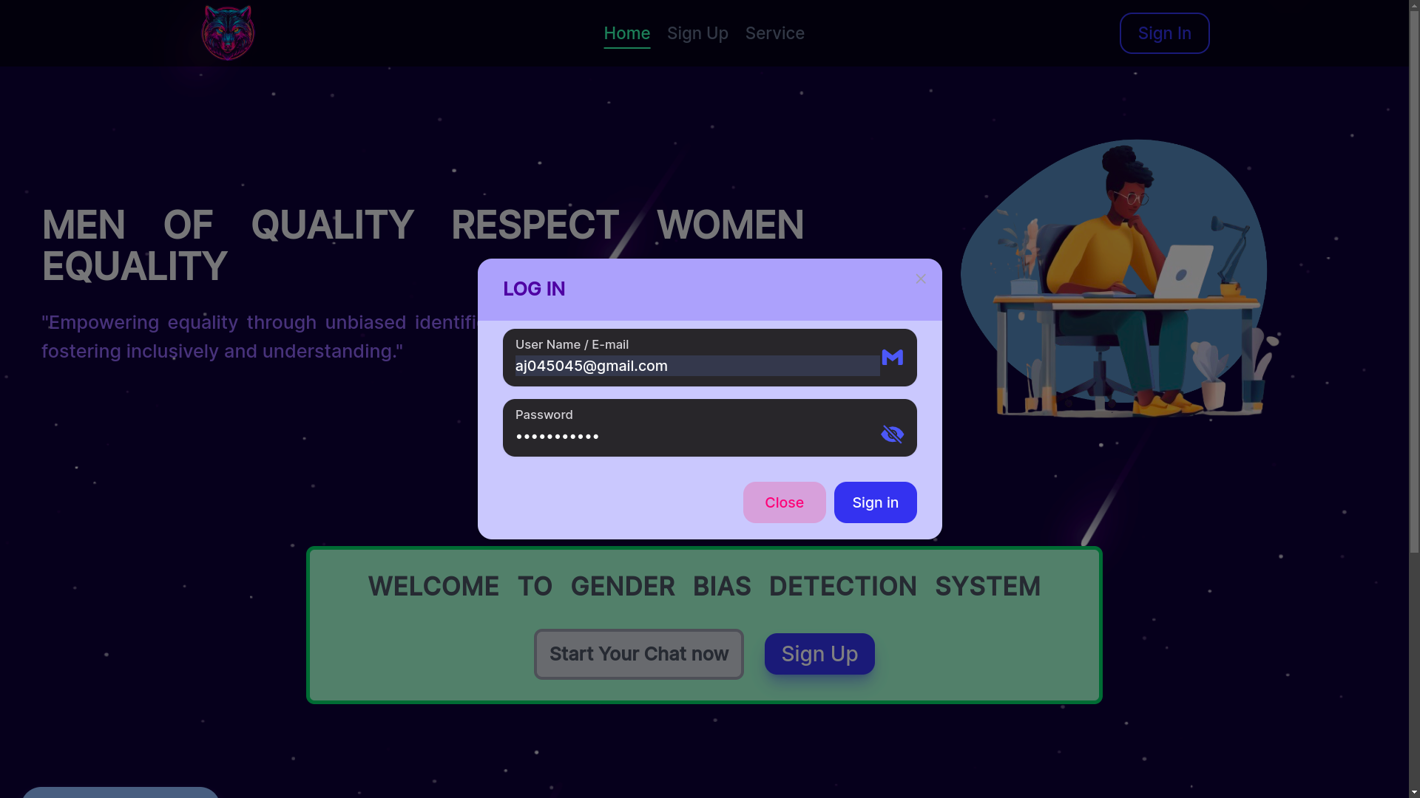
Sign In Page

Slide 31
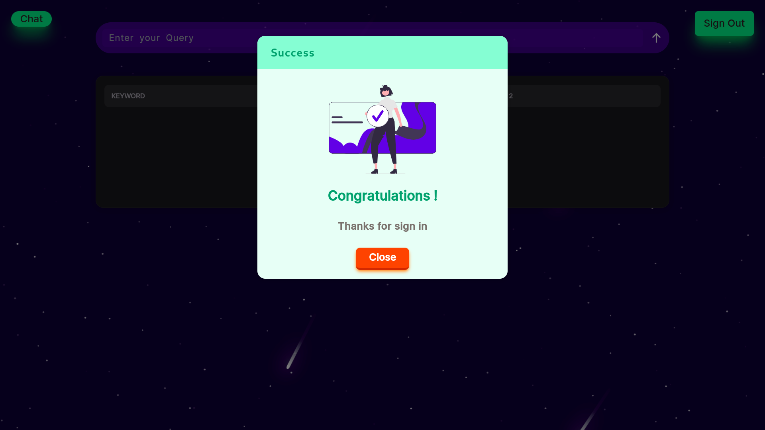
Success Message

Slide 32
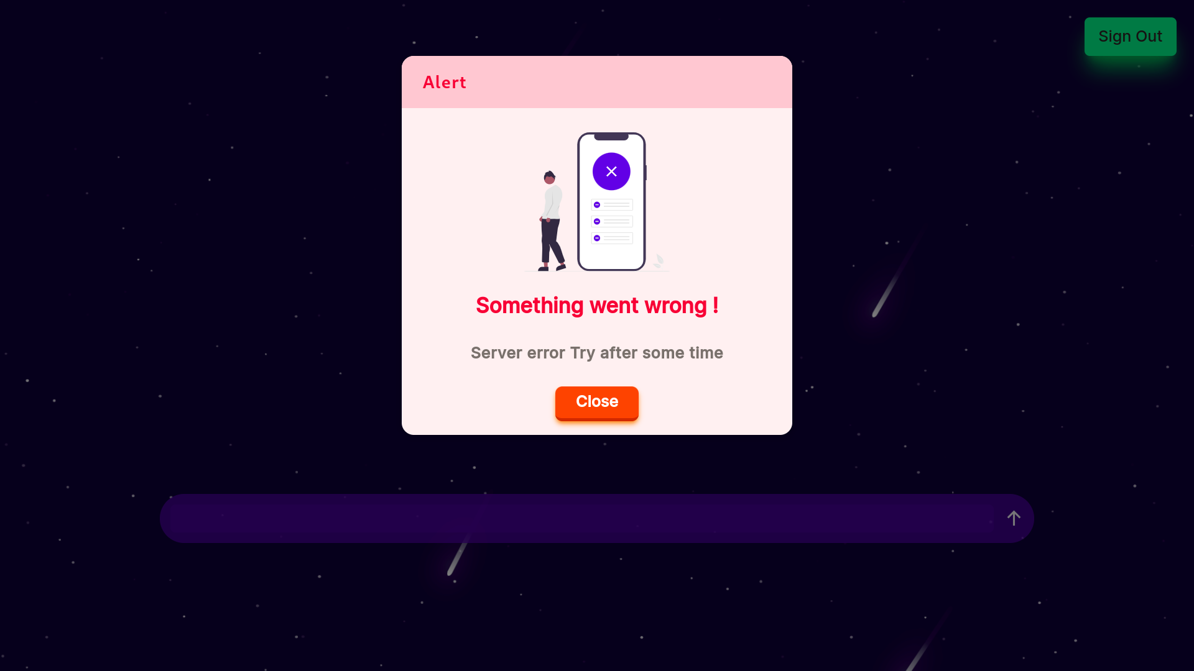
Error Message

Slide 33
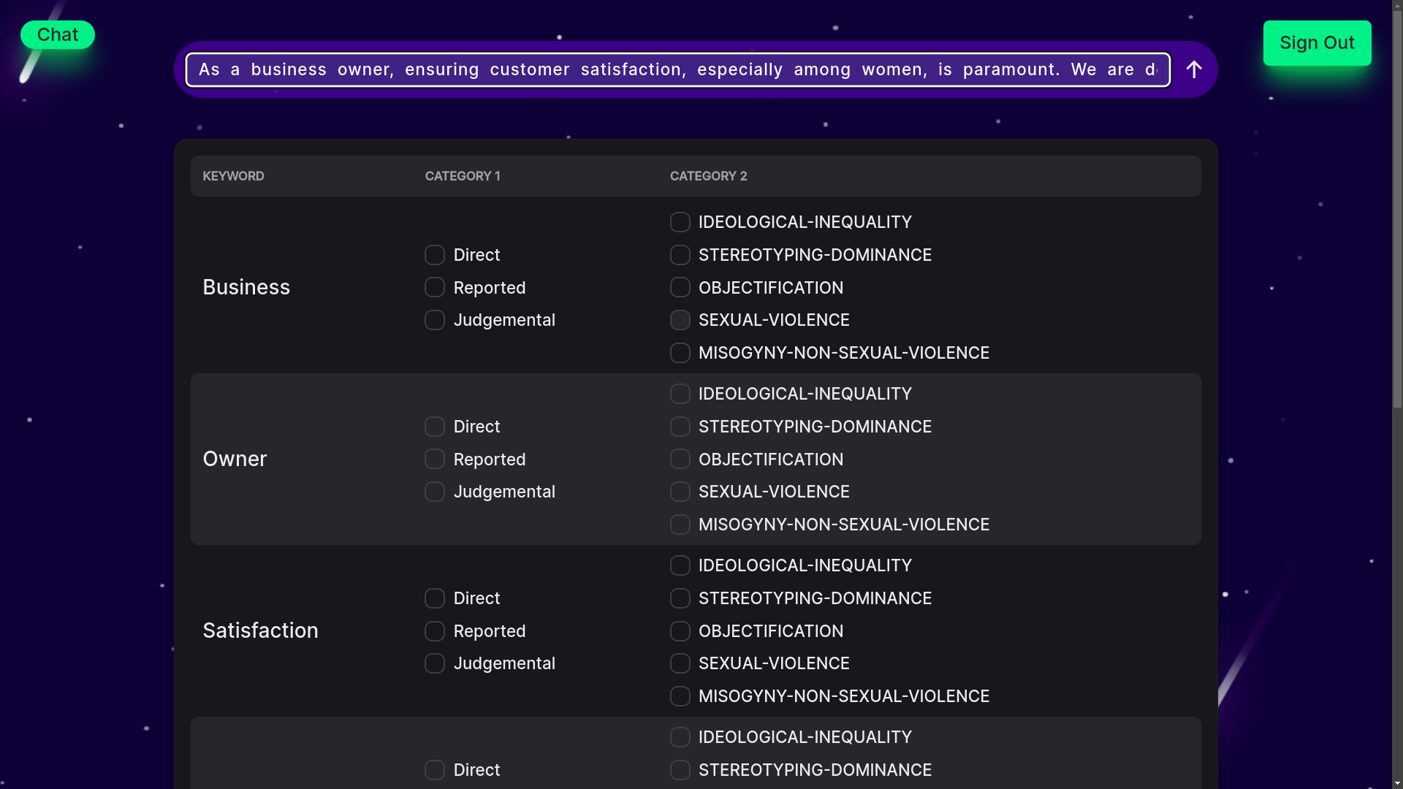
Admin Training Page

Slide 34
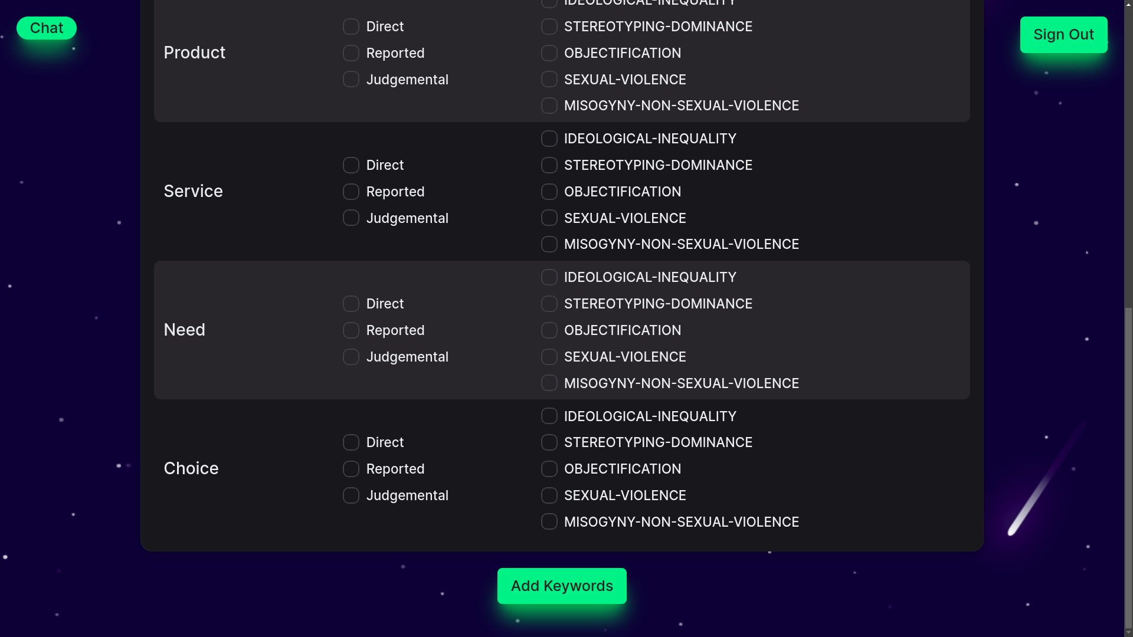
Admin Training Page

Slide 35
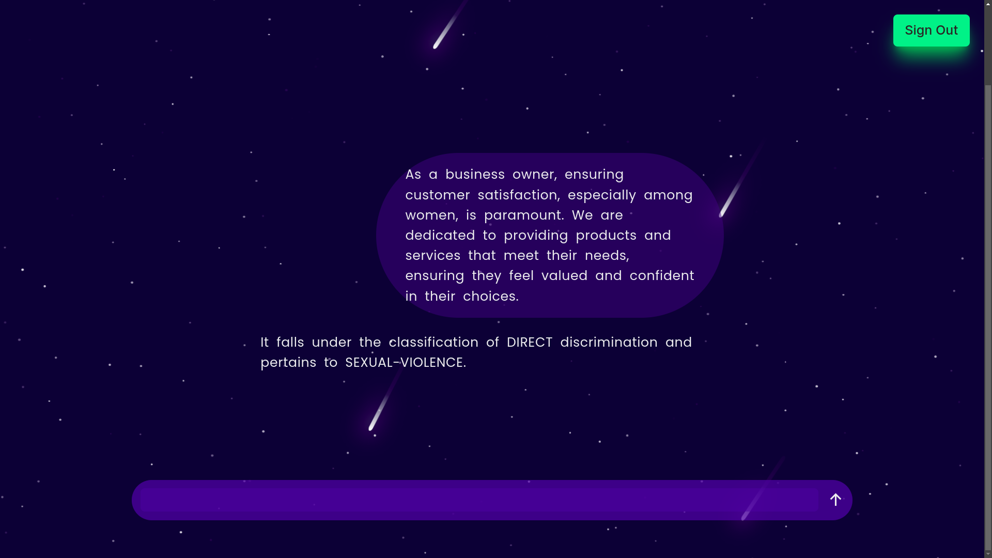
Chat Page

Slide 36
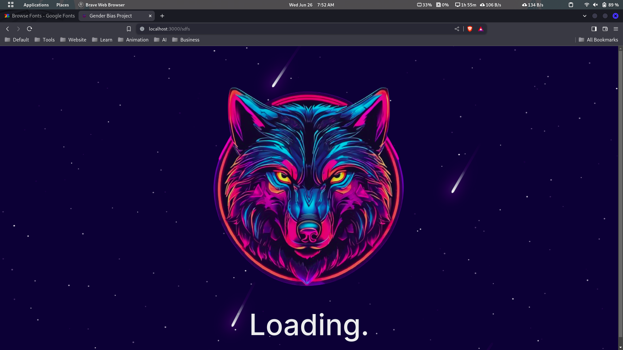
Loading Page

Slide 37
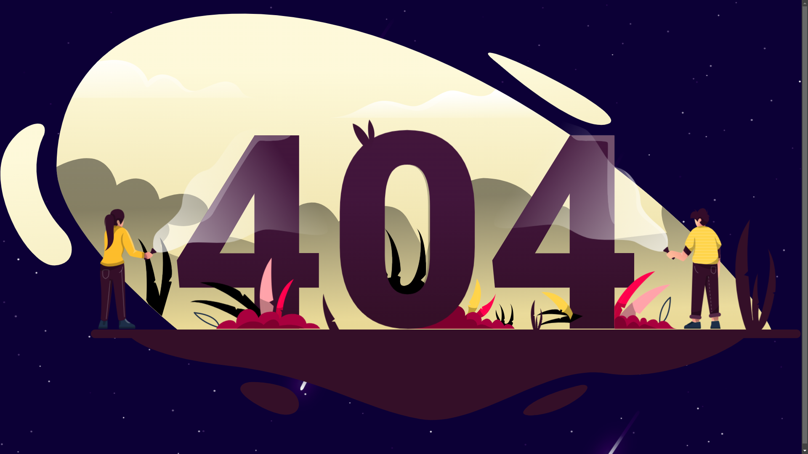
Error Page

Slide 38
Future Work
Integrate meme / Image recognition
Audio file processing
Implementing File Reading
Apply machine learning technique

Slide 39
Bibliography
Googlescholar :https://scholar.google.com/scholar?hl=en&as_sdt=0%2C5&q=gender+bias+in+media&btnG=&oq=gender
Github: https://github.com/yandexdataschool/nlp_course
Flask- https://flask.palletsprojects.com/en/3.0.x/
Redux - https://redux.js.org/

Slide 40
THANK YOU

